Slide 1
Equation of a Straight Line

Slide 2
What is a straight line?
A linear relation
All the points on the line with co-ordinates which can satisfy a given equation
Generally in the form of
y = mx + c
Where m = the gradient (slope) of the line and c = the constant (y-intercept)
y
x

Slide 3
Recall
Gradient could be positive or negative.
y
This gradient is negative. The y value decreases as the x value increases.
This gradient is positive. The y value increases as the x value increases.
x

Slide 4
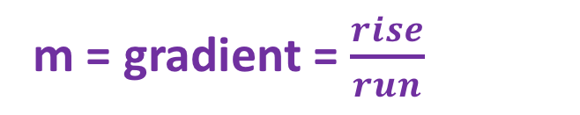
y
y = mx + c
y = mx + c
y = mx + c
c = y-intercept
The co-ordinate = (0,c)
m = gradient = $\frac{rise}{run}$
x

Slide 5
y
y = mx + c
y = mx + c
y = mx + c
c = y-intercept
The co-ordinate = (0,c)
m = gradient = $\frac{rise}{run}$
x

Slide 6
y
(6,6)
(0,3)
x

Slide 7
y
x
(-2, -1)
(0,-2)

Slide 8
y
(9,6)
x
(0,-3)

Slide 9
y
(4, 10)
(0,0)
x

Slide 10
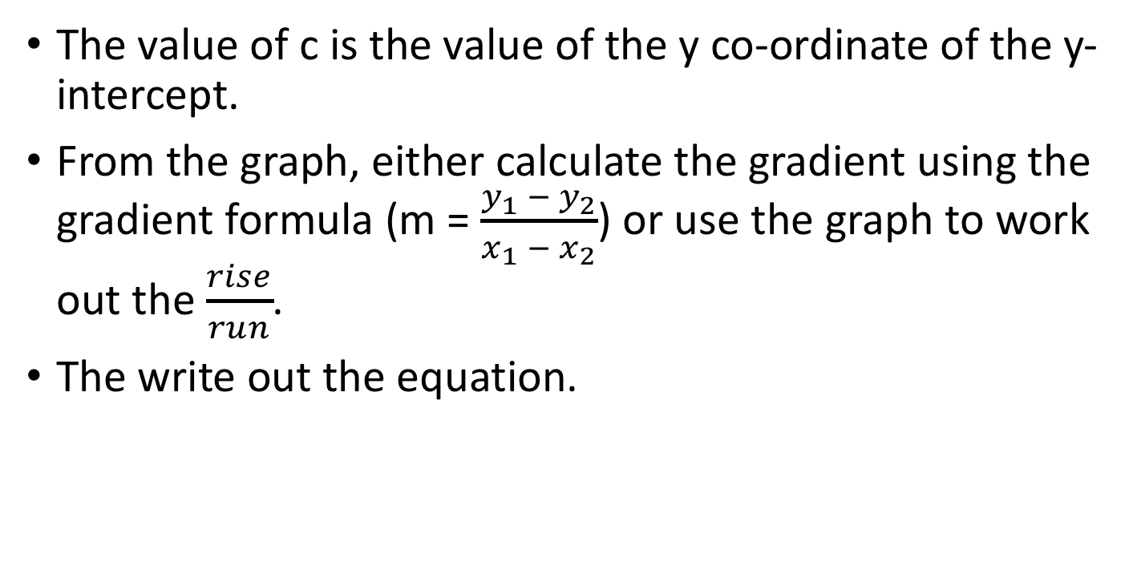
Procedure if you are given y-intercept and another point
The value of c is the value of the y co-ordinate of the y-intercept.
From the graph, either calculate the gradient using the gradient formula (m = $\frac{y_{1} − y_{2}}{x_{1} − x_{2}}$) or use the graph to work out the $\frac{rise}{run}$.
The write out the equation.

Slide 11
Find the equation (y = mx + c) that matches the following table of values
y-intercept = (0,-3)
Therefore c = -3
+2
+2
+2
+2
+2
+2
The difference = the gradient, m
Therefore in this case, m = 2
y = 2x - 3

Slide 12
Find the equation (y = mx + c) that matches the following table of values
y-intercept = (0,3)
Therefore c = 3
-3
-3
-3
-3
-3
-3
The difference = the gradient, m
Therefore in this case, m = -3
y = - 3x + 3

Slide 13
Find the equation (y = mx + c) that matches the following table of values
y-intercept = (0,-2)
Therefore c = -2
-2
-2
-2
-2
-2
-2
The difference = the gradient, m
Therefore in this case, m = -2
y = -2x - 2

Slide 14
Find the equation (y = mx + c) that matches the following table of values
y-intercept = (0,0)
Therefore c = 0
5
5
5
5
5
5
The difference = the gradient, m
Therefore in this case, m = 5
y = 5x

Slide 15
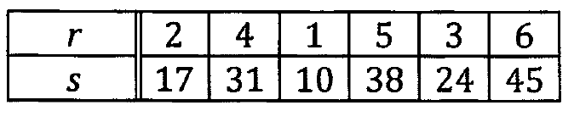
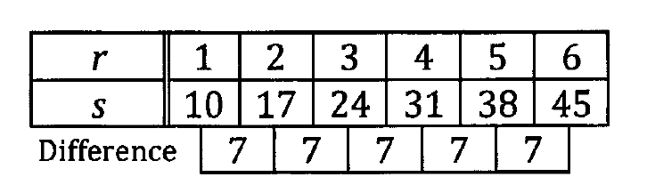

Slide 16
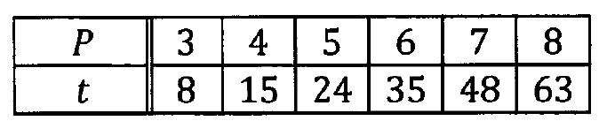
1
1
1
1
1
7
9
11
13
15
Difference is not constant, therefore this graph is not a linear graph.

Slide 17
Procedure if you are given a table of values
Work out the difference between the increment of y, that is the gradient, m. (in this case, you will be given the increment of x = 1).
From the table, determine the value of y when x = 0. This will be the value of c.
Substitute the values into y = mx + c

Slide 18
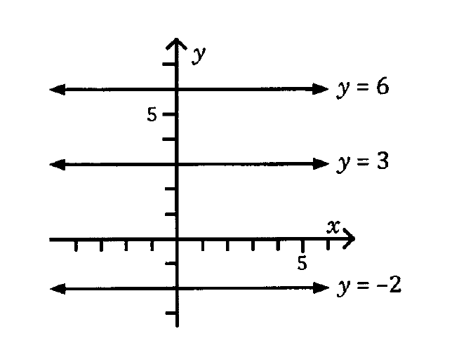
Line parallel to x - axis

Slide 19
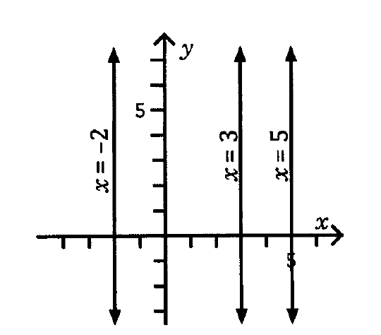
Line parallel to y - axis

Slide 20
Procedure if you are given y-intercept and another point
The value of c is the value of the y co-ordinate of the y-intercept.
From the graph, either calculate the gradient using the gradient formula (m = $\frac{y_{1} − y_{2}}{x_{1} − x_{2}}$) or use the graph to work out the $\frac{rise}{run}$.
The write out the equation.

Slide 21
Given a point and the gradient of the line or given two points
Use:
y – y₁ = m(x – x₁)

Slide 22
Example:
Find the equation of the line with the gradient -2 and the passing through (4, 2).

Slide 23

Example – Find the equation of a straight line which passes through the points (2,3) and (4,-5)
We know y = mx + c
Calculating m using (2,3) and (4,-5)
m = $\frac{y_{2} − y_{1}}{x_{2} − x_{1}}= \frac{−5 −3}{4 −2}= \frac{−8}{2}$ = -4
We therefore know that y = -4x + c
To calculate c, substitute either (2,3) or (4,-5) into the equation of y = -4x + c
Using (2,3), we therefore have
3 = -4(2) +c
3 = -8 + c
Rearranging, c = 3 + 8 = 11
Therefore the equation is y = -4x + 11
Using the gradient-point form :
y – y₁ = m(x – x₁)
Select either point:
Use (2,3)
y – 3 = -4 (x - 2)
y – 3 = -4x + 8
y = -4x + 11

